Slide 1

Text Enhancement of Photographs Taken with a Moving Smartphone
CS3200 Senior Project I
Project Advisor: Dobri Atanassov Batovski
Jian Pan 5728309
Xiaohan Yu 5718303

Slide 2
Content
Introduction
Objectives of the project
Scope of the project
List of Abbreviations
Limitations of the project
Literature review
Methodology
Test
Deliverable of the project
Gantt’ chart/Time table
References

Slide 3
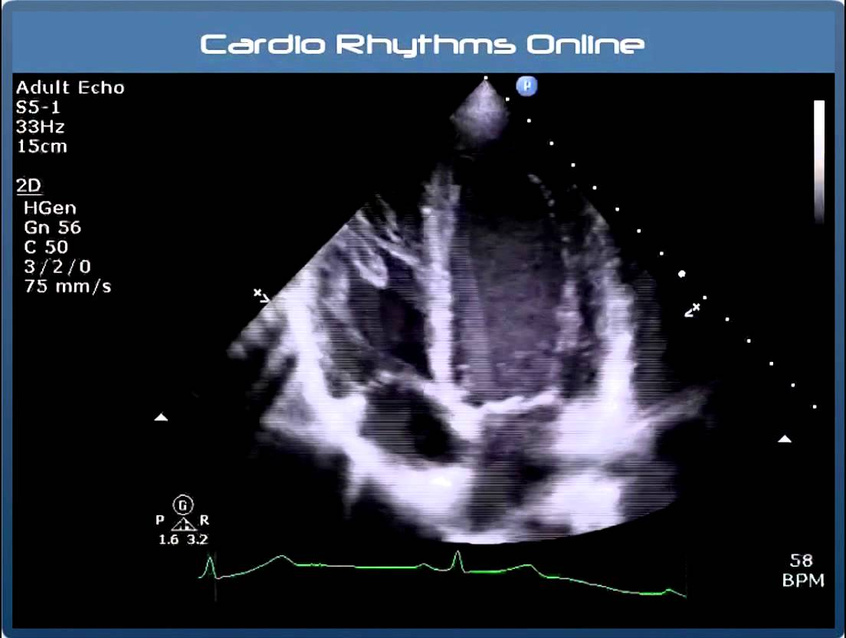
Introduction
Image deblurring is one of the key problems of restoring a degraded image.[23]
Blurring is usually caused by the acquisition of the same information from the scene on different receiver cells.
To exemplify:
Echo is a kind of blurring, because the same sound can be localized in multiple time intervals;
Source: YouTube, CardioRhythmsOnline ,Understanding Echo: Standard Imaging Views

Slide 4
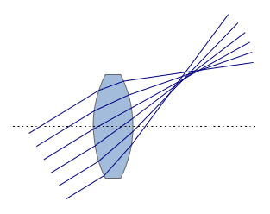

Introduction
Defocusing is a kind of blur because a single scene element is not found only on the pixels that is should activate, but also on neighboring pixels. It can either originate from wrongly adjusted focus distance in a camera, or the lack of focusing elements, like in the X-ray system;[24]
Source: Manuell Vectorisierte Version von: https://commons.wikimedia.org/wiki/File:Lens_coma.png

Slide 5
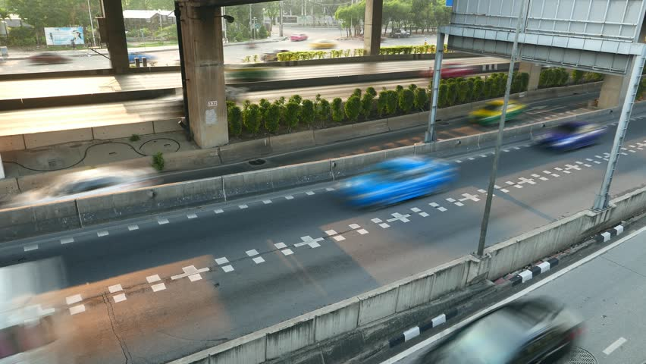
Introduction
Motion smudging is also a type of blur because the same signal lands on different receiver cells as the object or receiver is moving.[24]

Slide 6
Object of project
Deblurring the image taken by moving smart phone.
We hope can give a readable deblurred image for user to use with a simple way.

Slide 7
Scope of project
We focus on the motion deblurring.
But , without a signal inherently cannot physically focused [25]
(ex: high energy electromagnetic waves (X-rays), mechanical waves (sound/sonar))

Slide 8
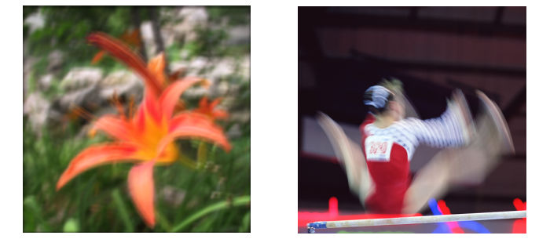
Scope of project: example
Camera motion blur
Object motion blur
Source: Single Image Motion Deblurring Using Transparency[23]

Slide 9
List of Abbreviations
MAP Maximum a Posteriori
PSF Point Spread Function
MLE Maximum Likelihood Estimator
RIF Inverse Filtering Method
EM Expectation Maximization
OCR Optical character recognition
OIS Optical Image Stabilization

Slide 10
Literature review
Reference [23] proved that we can compute the same blur filter f in both cases.
R[2]gives so a brilliant abstraction of the most popular methods deconvolution and artifact minimization in the software industry.
R[5] this textbook provides early and basic approaches usually assume a priori knowledge to estimate the blur filter in deblurring the input image.
R[4]propose a variational Bayesian approach using an assumption on the statistical property of the image gradient distribution to approximate the unblurred image.
R[25] propose a lot of algorithm for deblurring image

Slide 11
Literature review
R[3.22,14]propose natural image matting techniques.
In, R[17] , out of focus blur is considered in video matting using multiple cameras.
R[11,12] proposed model a blurred image as an autoregressive moving average(ARMA) process.
In R[10,19], recursive inverse filtering methods(RIF) are proposed to iteratively solve the image restoration problem
Image Matting – (transparency)
Matting refers to the problem of accurate foreground estimation in images and video [26]

Slide 12
Methodology – basic function
Motion blur is modeled as a linear image degradation process:
I = L ⊗ f + n
I : the degraded image,
L: unblurred (or latent) image,
n: the additive noise
⊗: convolution operator
f: is an unknown linear shift- invariant point spread function (PSF)

Slide 13
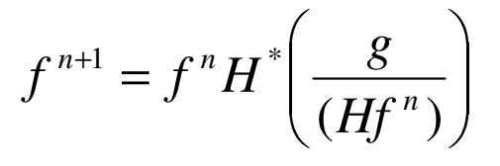
Methodology
Mode 1
Lucy-Richardson Algorithm & Poisson distribution
In the Richardson-Lucy algorithm, no specific statistical noise model is assumed.
This method requires no a priori information about the original image.
This function can be effective when you know the PSF but know little about the additive noise in the image.
It only works when the noise is not too strong.

Slide 14
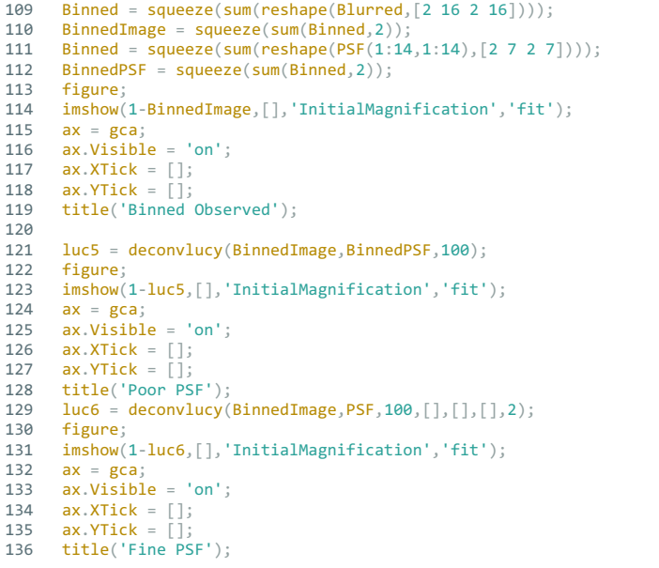
Methodology
Mode 1
Lucy-Richardson Algorithm
Codes Implemented by Matlab.

Slide 15
Methodology
Mode 2
LandWeber’s algorithm –
This method is an iterative inverse restoration filter.
It uses an extra convolution to stabilize against noise.
V (k+1) = V (k) + αHT (V blur − HV (k ).

Slide 16

Methodology
Mode 3
Tikhonov regularization:
It is linear only and assumes no a priori information about the noise model.

Slide 17
Methodology
We apply users several functions that are designed by previous modes.
User can choose the suitable function for their image that need to be deblurred
Limited by computation ability of CPU of mobile phones, the project applies the function that has been adjusted and avoid to let the user using their smart phone to compute every pixel directly.

Slide 18
Ideal Result
Text deburring using CNN image restoration

Slide 19
Test
Software
Stable/Performance Testing
White Box Testing -- tests internal structures or workings of an application

Slide 20
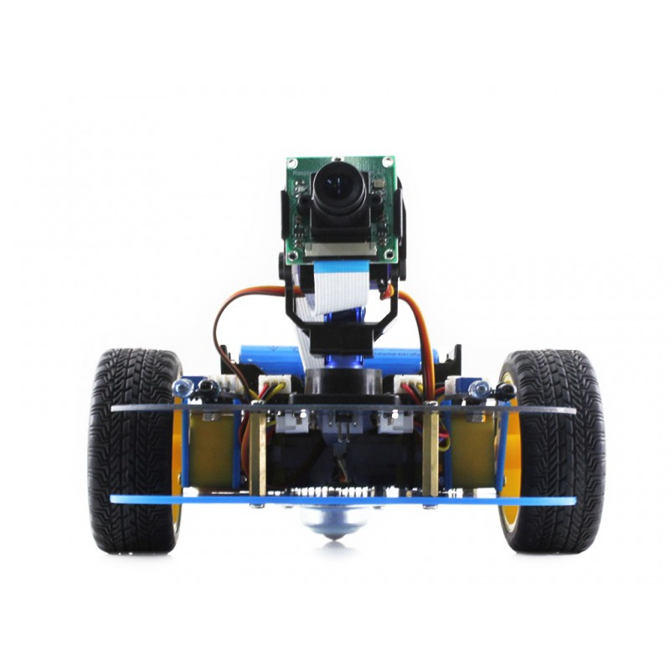
Test (Further and Optional)
Stress testing of Algorithm:
To simulate the programming of algorithm on Raspberry PI Robot Kit
To test the algorithm on a fast moving camera.

Slide 21

Limitation
One of the most unpleasant in image deblurring is ringing.
The other one is an image with too many noise.
As the inner function has been adjusted, if the image quality over priori function, the user may not find good result
For OCR, deblurred quality is quite poor.

Slide 22
Deliverables of the project
A programming written by Swift for IOS
A programming written by Java for Android(option).
Source codes of the project on GitHub
UML, Database design diagram
Report of the project
Slide of the project

Slide 23
Time Table/Gantt’ Chart

Slide 24
References
[1] M. Ben-Ezra and S. K. Nayar. Motion-based motion deblurring. TPAMI, 26(6):689–698, 2004.
[2] M. Chang, A. Tekalp, and A. Erdem. Blur identification using the bispectrum. IEEE Transactions on Signal Processing, 39(10):2323 – 2325, 1991.
[3] Y.-Y. Chuang, B. Curless, D. H. Salesin, and R. Szeliski. A bayesian approach to digital matting. CVPR, Vol. II, 264-271, 2001.
[4] R. Fergus, B. Singh, A. Hertzmann, S. T. Roweis, and W. T.Freeman. Removing camera shake from a single photograph. SIGGRAPH, 25(3):787 – 794, 2006.
[5] R. C. Gonzalez and R. E. Woods. Digital Image Processing (2nd Edition). Prentice Hall, 2002.
[6] P. C. Hansen, J. G. Nagy, and D. P. O’Leary. Deblurring Images: Matrices, Spectra, and Filtering. Society for Industrial and Applied Mathematic, 2006.
[7] A. Jain. Fundamentals of Digital Image Processing. Prentice Hall, 1988.
[8] J. Jia, J. Sun, C.-K. Tang, and H.-Y. Shum. Bayesian correction of image intensity with spatial consideration. In ECCV, pages III: 342–354, 2004.

Slide 25
References
[9] S. K. Kim and J. K. Paik. Out-of-focus blur estimation and restoration for digital auto-focusing system. Electronics Letters, 34(12):1217 – 1219, 1998.
[10] D. Kundur and D. Hatzinakos. A novel blind deconvolution scheme for image restoration using recursive filtering. IEEE Tran. on Signal Processing, 46(2):375 – 390, 1998.
[11] R. Lagendijk, J. Biemond, and D. Boekee. Identification and restoration of noisy blurred images using theexpectationmaximization algorithm. IEEE Transactions on Acoustics, Speech, and Signal Processing, 38(7):1180 – 1191, 1990.
[12] R. Lagendijk, A. Tekalp, and J. Biemond. Maximum likelihood image and blur identification: a unifying approach. Opt. Eng., 29(5):422 – 435, 1990.
[13] R. Lagendijk, A. Tekalp, and J. Biemond. Maximum likelihood image and blur identification: a unifying approach. IEEE Sig. Processing Magazine, 13(3):43 – 64, 1996.
[14] A. Levin, D. Lischinski, and Y. Weiss. A closed form solution to natural image matting. In CVPR, 2006.
[15] T.-H. Li and K.-S. Lii. A joint estimation approach for twotone image deblurring by blind deconvolution. IEEE Transactions on Image Processing, 11(8):847– 858, 2002.

Slide 26
References
[16] X. Liu and A. Gamal. Simultaneous image formation and motion blur restoration via multiple capture. In Int. Conf.Acoustics, Speech, Signal Processing, 2001.
[17] M. McGuire, W. Matusik, H. Pfister, J. F. Hughes, and F. Durand. Defocus video matting. ACM Trans. Graph.,24(3):567–576, 2005.
[18] J. W. Miskin and D. J. C. MacKay. Ensemble learning for blind image separation and deconvolution. In Advances in Independent Component Analysis, July 2000.
[19] M. Ng, R. Plemmons, and S. Qiao. Regularized blind deconvolution using recursive inverse filtering. Hong Kong Workshop on Scientific Computing, pages 110 – 132, 1997.
[20] R. Raskar, A. Agrawal, and J. Tumblin. Coded exposure photography: Motion deblurring via fluttered shutter. SIGGRAPH, 25(3):795 – 804, 2006.
[21] A. Rav-Acha and S. Peleg. Two motion blurred images are better than one. Pattern Recognition Letters, 26:311–317, 2005.
[22] J. Sun, J. Jia, C.-K. Tang, and H.-Y. Shum. Poisson matting. In SIGGRAPH, pages 315–321, 2004.
[23] Jiaya Jia, Single Image Motion Deblurring Using Transparency, IEEE Conference on Computer Vision and Pattern Recognition, 2007.
[24] M. Zaharescu, CA Boiangiu, Image deblurring: challenges and solutions, 2013 - wseas.us
[25] S.H.M. Allon M.G. Debertrand B.T.H.M. Sleutjes, Fast Deblurring Algorithms
[26] Jue Wang and Michael F. Cohen, Image and Video Matting: A Survey, Foundations and Trends® in Computer Graphics and Vision 3(2):97-175 · January 2007

